Slide 1
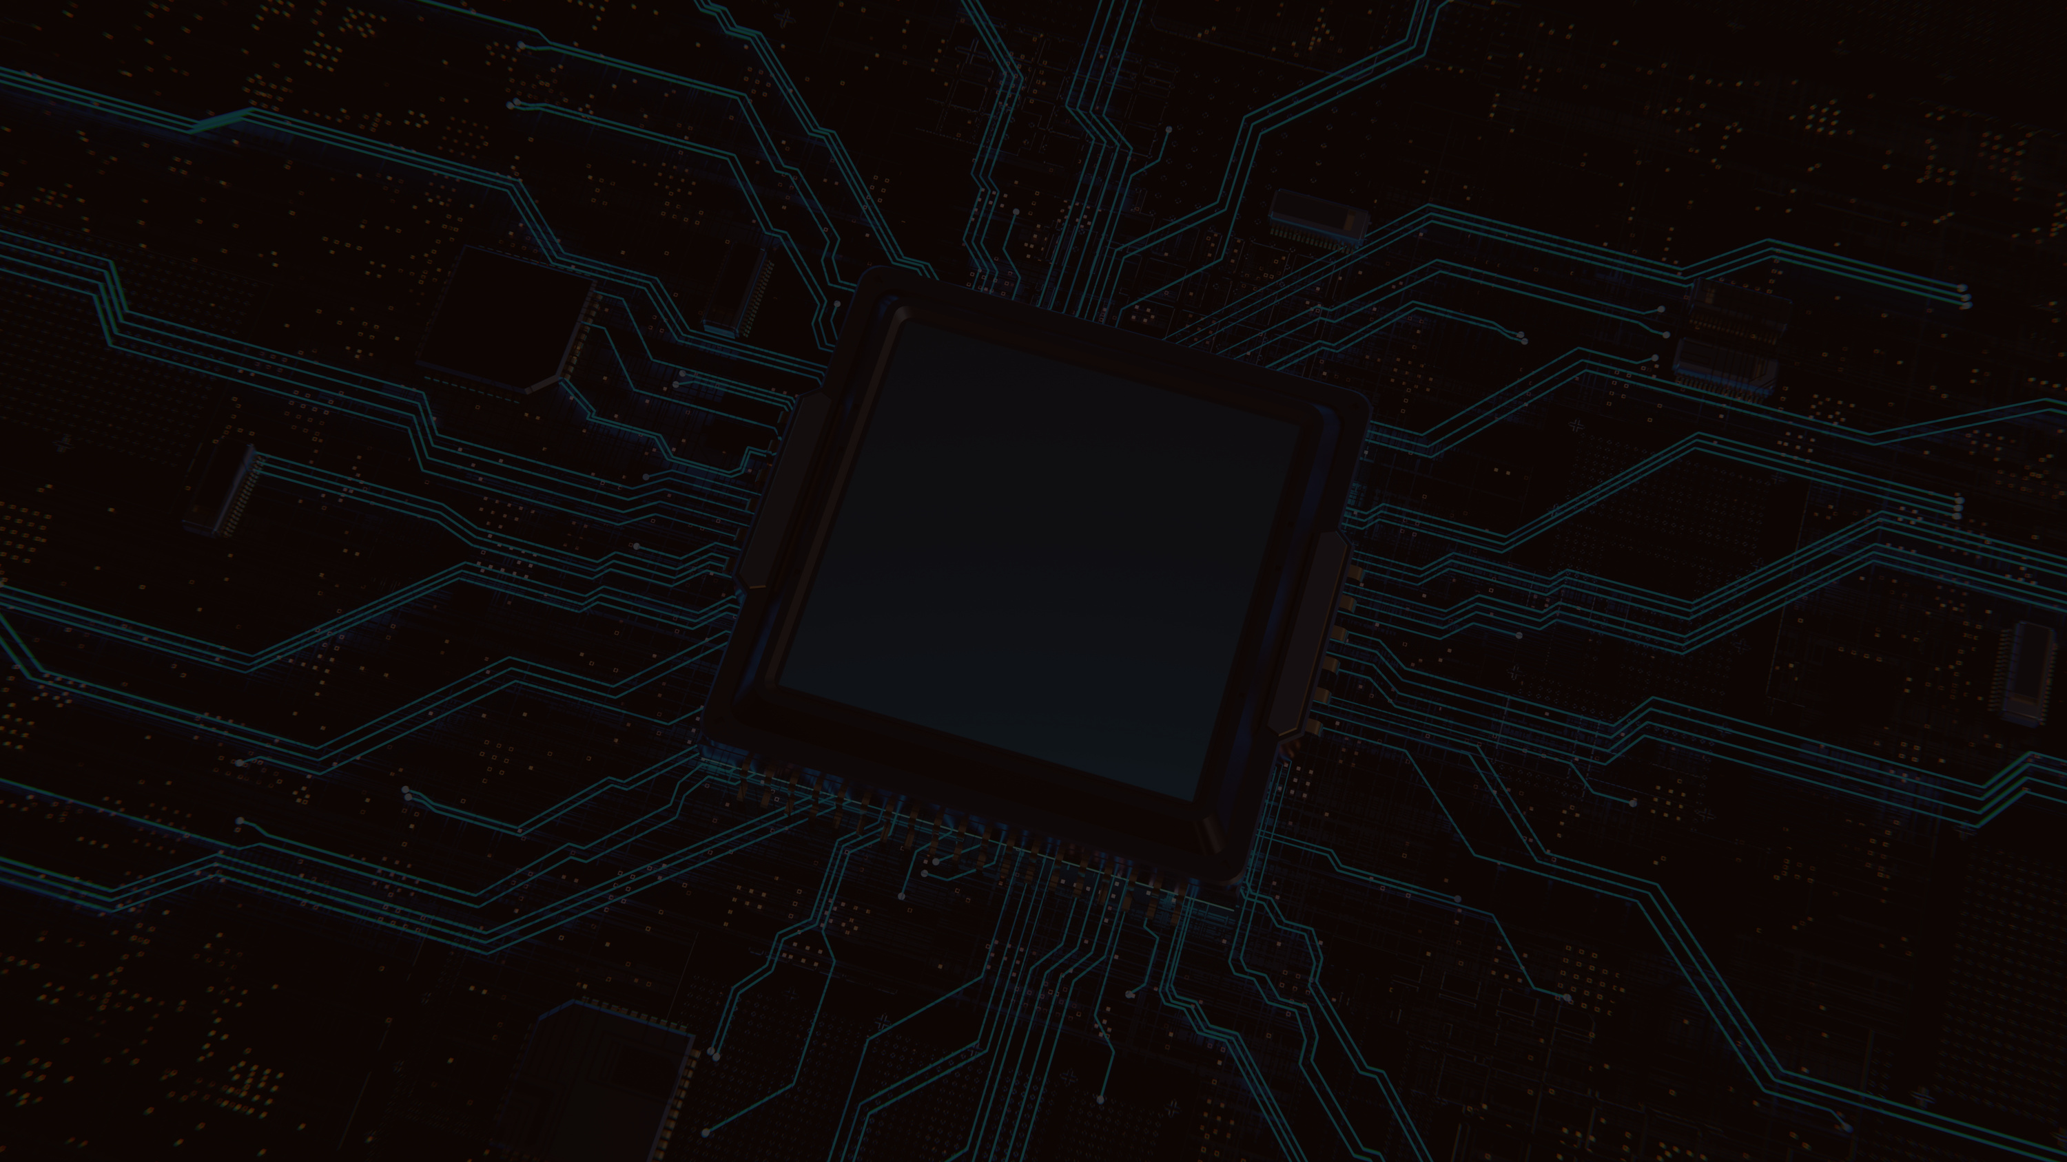




SENSORED 9.0
(LDR)

Slide 2
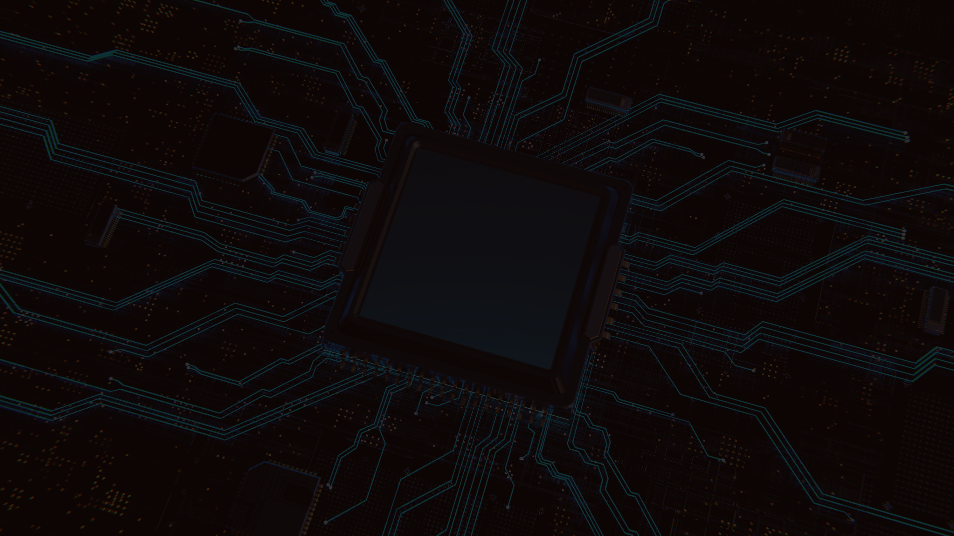

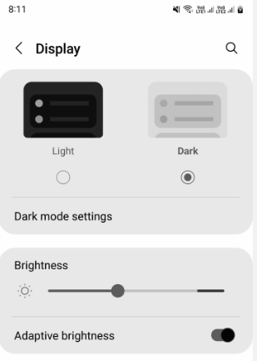
T
Do you know how the Auto Brightness feature of our smartphones work?

Slide 3

Notes:
The answer is LDR.
a sensor that changes resistance based on light intensity.

Slide 4
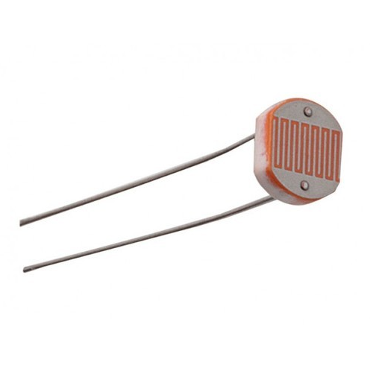
The smartphones have a hidden LDR sensor near the front camera which detects the ambient light and changes screen brightness accordingly

Slide 5


Slide 6
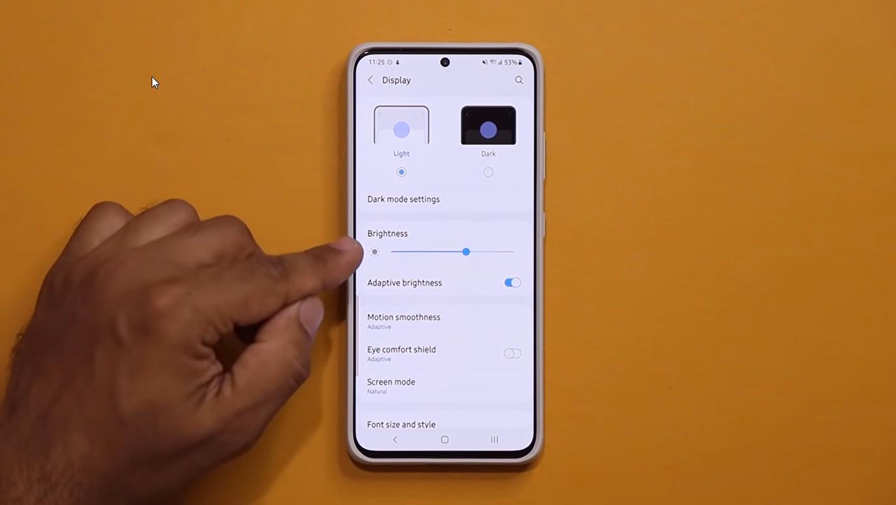
Notes:
Auto-brightness on smartphones works by using a LDR, typically located near the front-facing camera, to detect ambient lighting conditions. When the sensor detects a bright environment (like outdoors in sunlight), the screen brightness increases to improve visibility. Conversely, in low-light environments, the screen dims to reduce eye strain and conserve battery life. This system automatically adjusts the display brightness based on the sensor's input, enhancing both user experience and energy efficiency.

Slide 7
SO LET’S UNDERSTAND A LDR SENSOR IN DETAILS

Slide 8


Slide 9
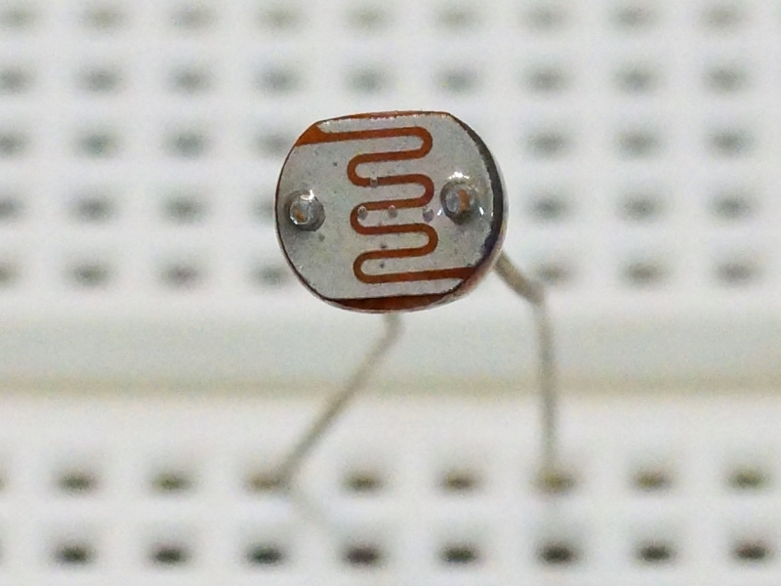
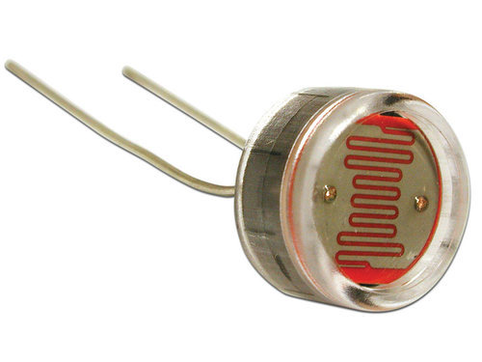
Light Dependent Resistor
Notes:
SO THIS IS THE LDR SENSOR
IT IS ALSO KNOWN AS PHOTORESISTOR, PHOTOCELL OR PHOTOCONDUCTOR

Slide 10
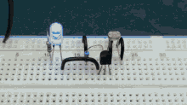
WORKING
LDR (Light Dependent Resistor) as the name states is a special type of resistor that works on the photoconductivity principle means that resistance changes according to the intensity of light.
Notes:
What is photoconductivity principle?anyone
So basically photoconductivity is the phenomena by which a material’s electrical conductivity increases when it’s exposed to light.This happens because light causes electron to move to higher energy levels. So the working principle of LDR is photosensitivity principle

Slide 11
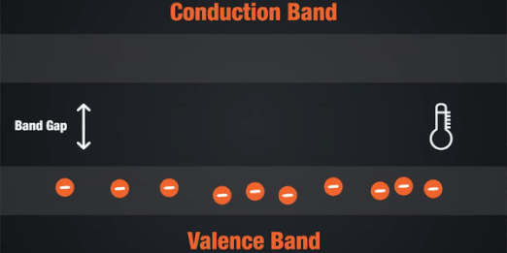
Semiconductors are the materials which have a conductivity between conductors (generally metals) and non-conductors or insulators (such as ceramics). Semiconductors can be compounds such as gallium arsenide or pure elements, such as germanium or silicon
Notes:
Valence Band
The energy band involving the energy levels of valence electrons is known as the valence band.
Conduction Band
It is the lowest unoccupied band that includes the energy levels of positive (holes) or negative (free electrons) charge carriers. It has conducting electrons resulting in the flow of current.
Can anyone explain what is going on in this picture?
When we heat a semiconductor,energy is supplied to the electrons in the valence band. If this energy becomes sufficient (equal to or greater than the band gap energy) some of the electronds from the valence band excites and jump to the conduction band.

Slide 12
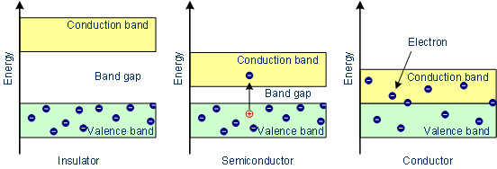
Notes:
The energy band diagram of insulator,semiconductor and conductor.
THE ENERGY DIFFERENCE BETWEEN VALENCE BAND AND CONDUCTION BAND IS CALLED THE BAND GAP.
The band gap of an insulator is between 3-4 electron volts(Ev).
The band gap of a conductor is 0
The semiconductor like si have a band gap of 1.1 ev and germanium have 0.66ev

Slide 13
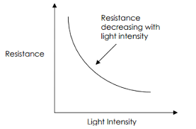
DEPENDANCY OF RESISTANCE ON INTENSITY OF LIGHT :
Notes:
Low light:LDRs have high resistance in low light
High light: LDRs have low resistance inb

Slide 14
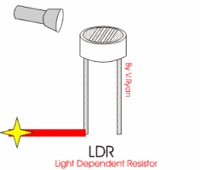
When photons with sufficient energy strike the LDR, electrons in the semiconductor material are excited to the conduction band, resulting in an increase in the number of charge carriers and a decrease in resistance

Slide 15
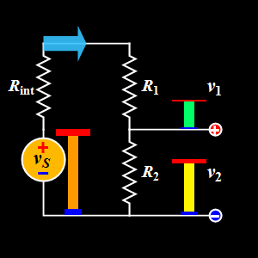
POTENTIAL DIVIDER
Notes:
Potential divider is a circuit that uses resistors to divide an input voltage into smaller output voltages
It is used in: tuning or volume control,triggering a transistor, used to control the temperature in a fridge.

Slide 16
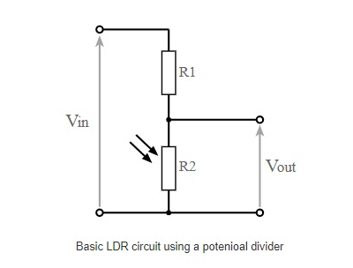


Slide 17
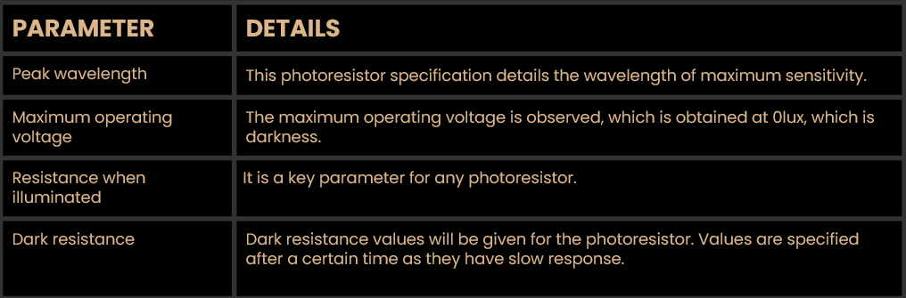
LDR (PARAMETERs)
Notes:
Does anyone know what is the SI unit of light intensity? The SI unit for light is lux(lx) , which is the unit of illuminanace or luminous flux per unit area.

Slide 18
1 candela is thus equal to 1 lumen per steradian. When a beam with a strength of 1 lumen falls on a surface of 1 square meter, this gives an illuminance of 1 lux. 1 lux is therefore equal to 1 lumen per square meter.
Notes:
Does anyone know what is the SI unit of light? The SI unit for light is lux(lx) , which is the unit of illuminanace or luminous flux per unit area.

Slide 19
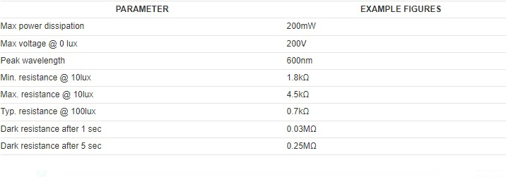
DEVICE SPECIFICATION
Notes:
Maximum Power Dissipation: the maximum amount of power that a component can transfer without overheating. The max. power dissipation of an LDR module is 200 milliwatts.
Peak Wavelength: the wavelength at which a light source’s radiometric emission spectrum reaches its highest value. It is measured with a spectrometer.

Slide 20

Notes:
Some of you might be thinking to skip the device specification. But its important

Slide 21

WHY LDR SENSOR ?
Notes:
WHY LDR SENSOR?
ANYONE KNOW WHAT ARE THE APPLICATIONS OF LDR SENSOR IN DAY TO DAY LIFE

Slide 22
APPLICATIONS
Notes:
Moving to the application part

Slide 23


Slide 24
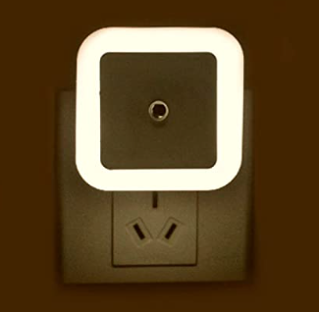
SMART LIGHTS
Notes:
So basically A smart light with an LDR detects ambient light levels. When the surrounding light falls below a certain threshold, the LDR increses resistance, triggering the light to turn on automatically and vice versa.

Slide 25
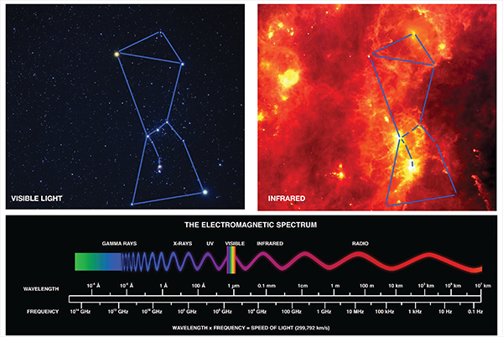
INFRARED ASTRONOMY
Notes:
In infrared astronomy, LDR is used to detect changes in INFRARED light intensity, helping to capture and analyse celestial object that emits infrared radiation.

Slide 26
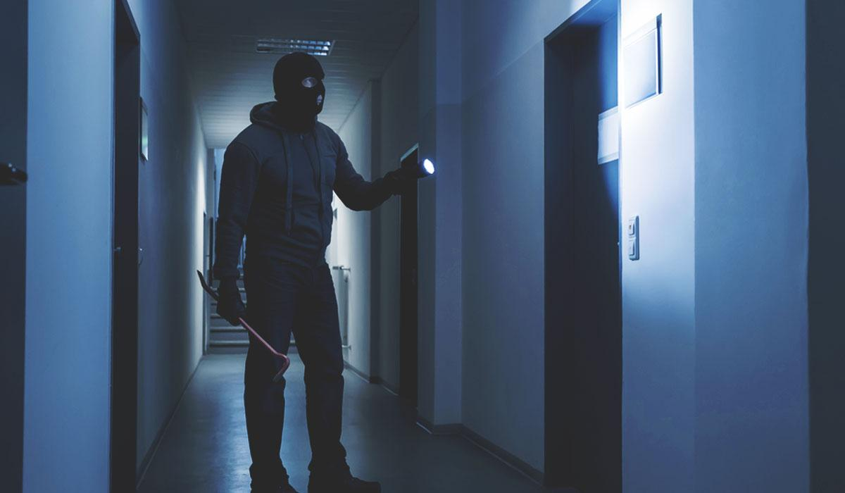
BURGLAR ALARM SYSTEM
Notes:
When the light level changes unexpectedly,such as when a person passes by or interrupt the light source, the LDR triggers the alarm,signaling a possible intruition.

Slide 27


IT’S PRACTICAL TIME NOW

Slide 28
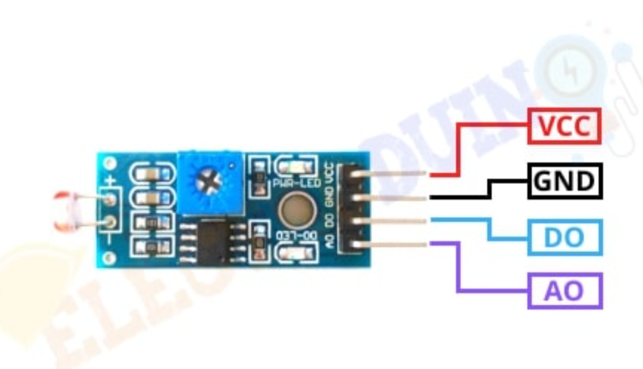
PIN DIAGRAM
V

Slide 29
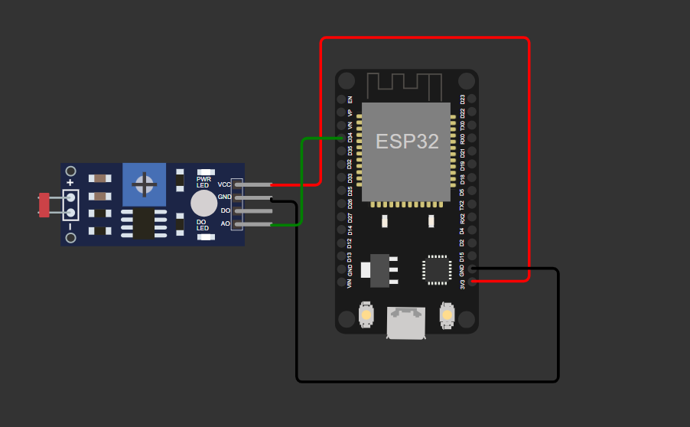
CIRCUIT DIAGRAM
VCC →3V
GND of LDR module → GND of ESP32
A0→D34 OF ESP32
Notes:
So here VCC is connected to 3v
GND of LDR module is connected to GND of ESP32
A0 is connected to D34

Slide 30
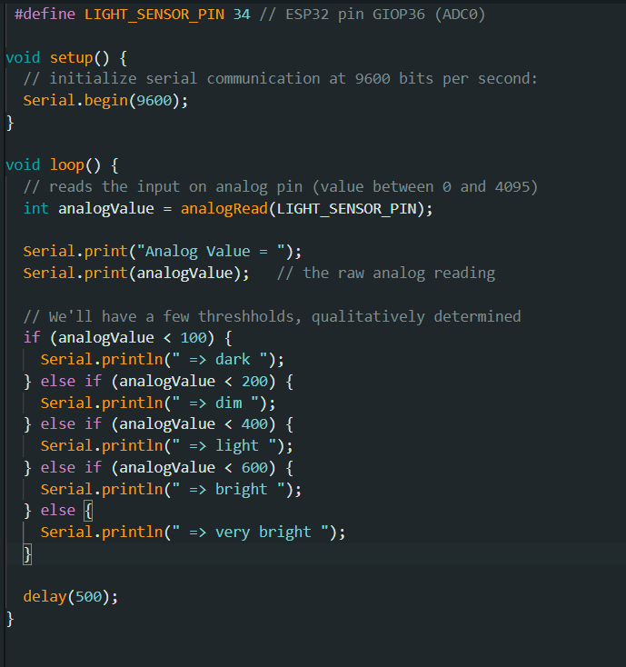
CODE

Slide 31
THANK YOU

